Slide 1
Chapter 7: Auditing for Social Aspects
Contemporary Issues in Social Accounting

Slide 2
Chapter Structure
Introduction
External social audit
Supply chain auditing
Self-generated social audit

Slide 3
Introduction
Origins of social audit movement can be traced to 1950s
Pioneering work of George Goyder important in this respect
Goyder identified several limitations with existing financial auditing model – it was one-sided and overlooked the social
Society should make greater accountability demands
First movements in social audit therefore took place at the level of civil society

Slide 4
External social audit
Early developments
Government, local authorities and NGO audits
Consumer audits

Slide 5
Early developments
Charles Medawar an important figure
Those in positions of power who are charged with making decisions on behalf of, and in the interests of, stakeholders should be held accountable for those decisions
Several important organisations, including:
Social Audit Ltd
Counter Information Services (CIS)
Green Peace, Friends of the Earth, UN Development Programme, Christian Aid, amongst others

Slide 6
Early developments (2)
Social Audit Ltd
Pioneering organisation first active in 1970s, producing reports on several organisations
Report on Avon Runner probably most prominent example
Reports covered issues including, among others,
Labour issues
Health and safety
Pollution
Waste Disposal

Slide 7
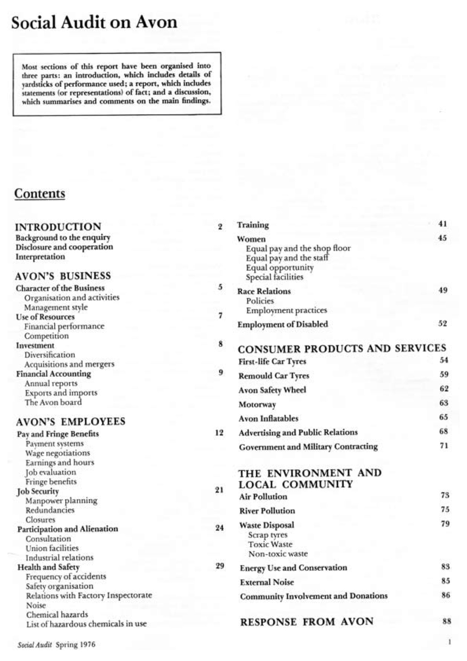
Contents page of Social Audit Ltd report on Avon Rubber
Available from:
https://www.st-andrews.ac.uk/media/csear/app2practice-docs/CSEAR_avonrubber-lowqual.pdf

Slide 8
Early developments (3)
Counter Information Services (CIS)
Produced Anti-Reports (see http://www.anti-report.com/)
Concentrated mainly on organisations in industries with largest workforces
Included organisations such as the NHS, Ford and Unilever
Contrasted profit with wages
Looked at the privatisation of the private sector

Slide 9
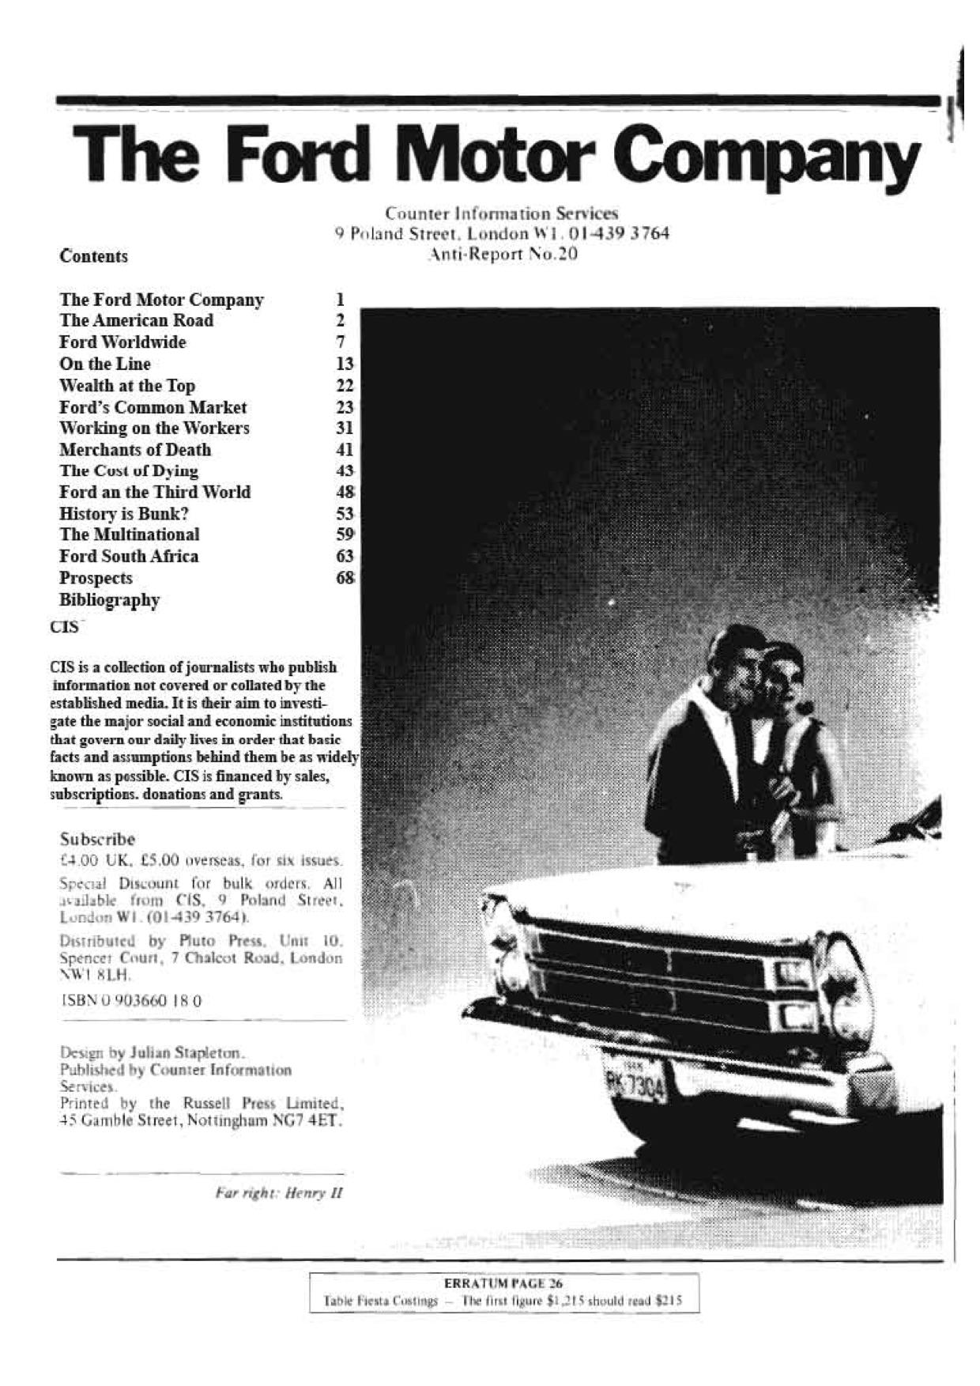
Example of CIS Anti-Report
http://www.anti-report.com/library-page-2/4563795293

Slide 10
Government, local authorities and NGOs
Historically important development, particularly in UK because of rapidly changing industrial environment in the United Kingdom during the early 1980s where, driven by de-industrialisation and rising unemployment
Several social audits conducted by councils in the UK
Outside of UK, local government and NGOs in several developing countries including Bangladesh, India and Pakistan as well as several countries on the African continent

Slide 11
Consumer audits
Consumers’ Association
Which? Magazine
Ethical Consumer and New Consumer journals
Ethical Company Organisation
Ethical Company Index
The Good Shopping Guide
The Good Nutrition Guide
Consumers International

Slide 12
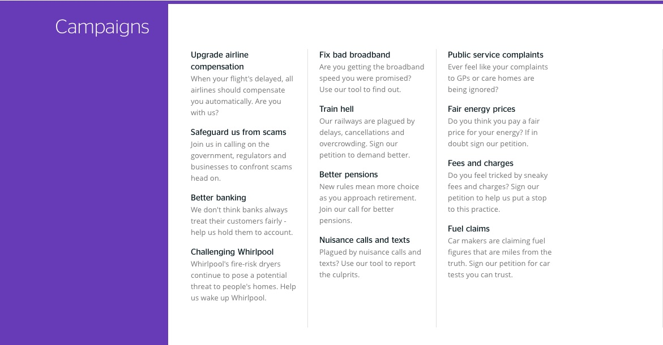
Example of Which? active campaigns
Available at: http://www.which.co.uk/

Slide 13
Supply chain audit
An introduction to supply chain audit
Codes of conduct and external standards
The who and how of supply chain audits
The impact of supply chain audits

Slide 14
An introduction to supply chain audit
Globalisation resulted in expansion of operations of many organisations
Scandals and public criticism, primarily within garment and footwear industry
Low wages
Poor working conditions
Human rights violations
Supply chain audits
Evaluate the working conditions and practices of factories and production sites within the supply chain

Slide 15
Codes of conduct and external standards (1)
Codes of conduct developed by organisations to protect workers’ rights
Development of codes has been criticised for being ad hoc and inconsistent
SA8000 standard developed by Social Accountability International to address this inconsistency

Slide 16
Codes of conduct and external standards (2)
SA8000 standard covers the following nine areas:
Child labour
Forced or compulsory labour
Health and safety
Freedom of association and right to collective bargaining
Discrimination
Disciplinary practices
Working hours
Remuneration
Management systems

Slide 17
Codes of conduct and external standards (3)
In addition to SA8000, several other standards have developed in the area of supply chain audit,
Includes the Ethical Trading Initiative (ETI) was established in 1998 with the objective “to improve the lives of workers in global supply chains”.
The ETI has a base code that is similar in nature to SA8000

Slide 18
Codes of conduct and external standards (4)
Other initiatives include:
Business Social Compliance Initiative (BSCI),
WRAP,
ICTI CARE Foundation
The Sedex Members Ethical Trade Audit (SMETA) audit

Slide 19
The who and how of supply chain audits (1)
Who conducts supply chain audits?
Verification of suppliers out by an independent party who is external to the organisations within the supply chain’
This is not always the case in practice, however.
There are two main types of social auditor:
The internal social auditor
The external social auditor

Slide 20
The who and how of supply chain audits (2)
Internal social auditor
Employed by organisation that is in some way responsible for the activities that are being audited
Less objective than an external party
Likely to put interests of employees ahead of interests of other stakeholders such as employees

Slide 21
The who and how of supply chain audits (3)
External social auditors
Not employed by organisation so are more independent than internal social auditors
Often work for commercial organisations such as commercial audit firms
Again, interests of employees might not be primary motive

Slide 22
The who and how of supply chain audits (4)
How are supply chain audits conducted?
Interviews
Observation and inspection of documentation
Observation and inspection of sites

Slide 23
The impact of supply chain audit
Received criticism for being ineffective and insufficient
There have been a number of significant failures in the social audit process, such as Nike in 2005
Studies have shown that supply chain audits have rarely resulted in improved conditions for workers
For further information see Clean Clothes report (http://digitalcommons.ilr.cornell.edu/cgi/viewcontent.cgi?article=2077&context=globaldocs)

Slide 24
Self-generated social audit
Introduction to self-generated social audit
The nature and purpose of self-generated social audit
The scope of self-generated social audit
How are self-generated social audits conducted?
How are self-generated social audits reported?
Who conducts self-generated social audits?

Slide 25
Introduction to self-generated social audit(1)
Builds on the early work of Traidcraft plc and the New Economics Foundation
Holistic approach involving internal and external stakeholders, and the production of a report detailing this
Resulted in creation of social audit methodology that became a model of good practice

Slide 26
Introduction to self-generated social audit (2)
Further developed by a host of organisations in the UK, including:
Strathclyde Community Business Ltd, who developed the “Scottish” model
Industrial Common Ownership Movement, who developed the “Beechwood” model
Social Audit Network, who have produced several publications and provide a register of ”approved” social auditors
Self-generated social audit has also developed outside UK, with significant developments in New Zealand, India, Nepal, the Philippines, South Africa and Canada

Slide 27
The nature and purpose of self-generated social audit (1)
“a logical and flexible framework that will enable your organisation to build on existing documentation and reporting systems and develop a process whereby you can: account fully for your organisation's social, environmental and economic performance and impact; report on that performance and impact; provide the information essential for planning future action and improving performance; and be accountable to all those you work with and work for” (Social Audit Network).

Slide 28
The nature and purpose of self-generated social audit (2)
There are several key principles of self-generated social audit:
Inclusive
Regular
Engaging
Verifiable
Continuously improving
Comparable:

Slide 29
The scope of self-generated social audit
Self-generated social audit can cover several issues, including:
Ethics
Staffing
Environment
Human rights
Community
Compliance

Slide 30
How are self-generated social audits conducted?
Self-generated social audit involves the collection of data, via:
Stakeholder questionnaires
Reviews of secondary sources, such as policy documents, external standards and other regulations
Stakeholders have an important role to play
Stakeholders should continue dialogue with organisations to hold organisations to account for their actions

Slide 31
How are self generated social audits reported?
Social audit document should be made available to all stakeholders
Reports are a means of communication between organisation and key stakeholders
However, in some instances social audit reports have been found to be window dressing devices designed to limit the potential liability of organisations

Slide 32
Who conducts self-generated social audits? (1)
Similar to supply chain audits, self-generated social audits can be conducted by either internal or external parties
However, these types of social audits are most likely prepared by parties internal to the organisation and then reviewed by an independent external social auditor
SAN maintain a register of “approved” social auditors on their website (http://www.socialauditnetwork.org.uk/social-auditor/register-of-social-auditors/)

Slide 33
The effectiveness and impact of self-generated social audit
Social audit report is an important communicative device
However, the usefulness of social audit reports has been questioned in some instances
It has been found that social audit reports amount to window-dressing designed to improve the organisation’s public image and appeal to a wider range of stakeholders
Social audit reports have been criticised for being an ineffective strategy for engendering change
Rather they are used as a means of limiting the potential liability of organisations

Slide 34
Who conducts self-generated social audits? (2)
Currently no formal or standardised training for social auditors
There have moves to professionalise the practice of social auditing
The AA1000 framework includes recommendations to create a professional social auditing qualification
This will cover
The competencies and knowledge required of social and ethical accountants and auditors,
Recommendations of the level of professional training considered necessary to support social auditors in meeting the required standard of competency
How these standards and levels can be maintained

Slide 35
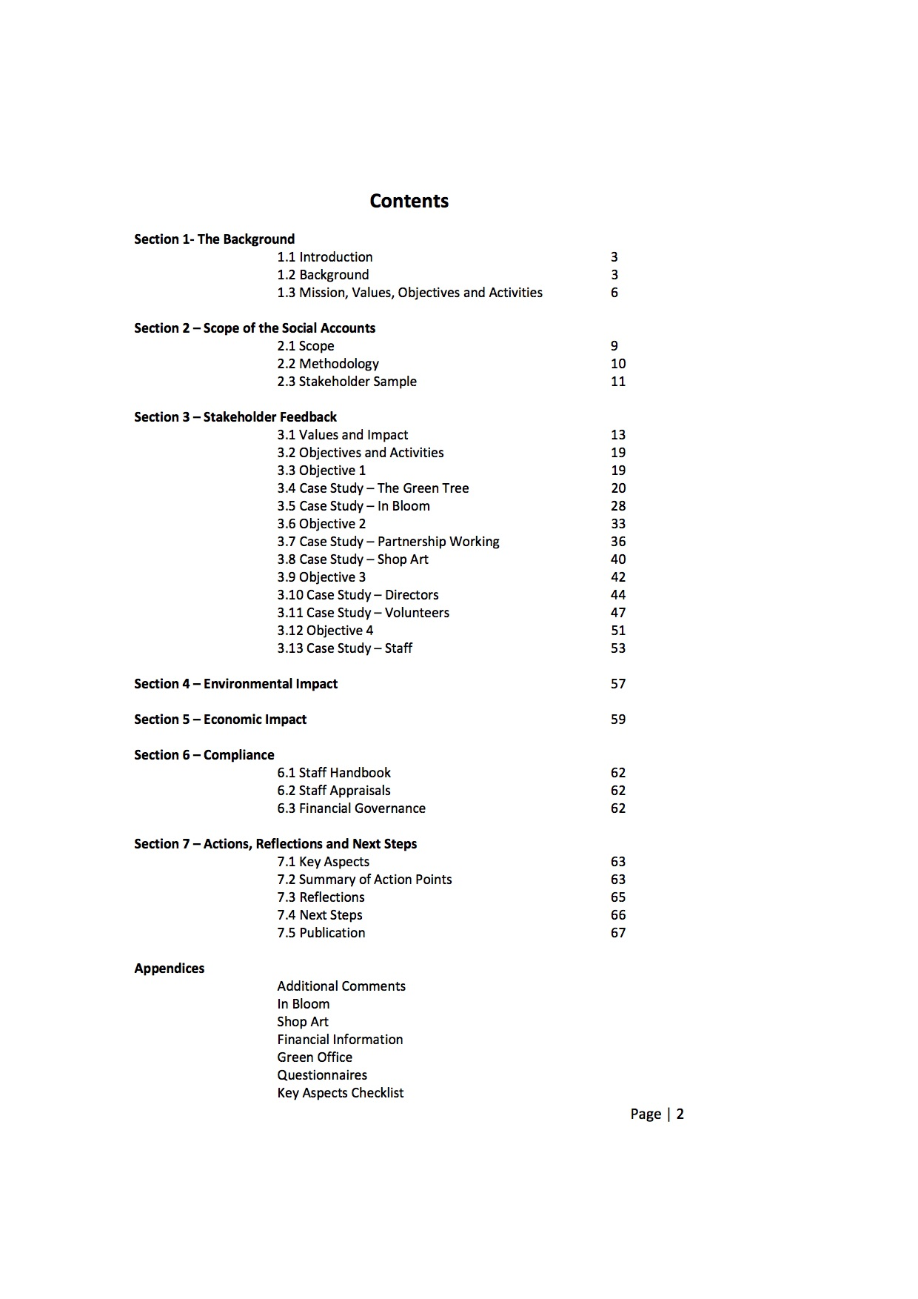
Example of social accounts and audit report
Extract from Banff and Macduff Community Trust Report, 2009-10, available at: http://www.socialauditnetwork.org.uk/files/8713/4917/6036/BMCT_Social_Audit_DRAFT_-_2010.pdf

Slide 36
Summary
Three main forms of social audit
External social audit
Supply chain auditing
Self-generated social audit
The impact of social audit has been questioned
More work required, including increased participation by stakeholders both internal and external to organisations

Slide 37
Further reading and useful links
CIS Anti-Reports
http://www.anti-report.com/anti-reports/4559023241
Social Audit Network
http://www.socialauditnetwork.org.uk/
Green Peace reports
https://www.greenpeace.org.uk/what-we-do/reports/
Friends of the Earth Reports
https://www.foe.co.uk/resource

Slide 38
Further reading and useful links (2)
Which? Magazine
http://www.which.co.uk/
Ethical Company Organisation
http://ethical-company-organisation.org
Consumers International
http://www.consumersinternational.org
SA8000 Standard
http://www.sa-intl.org/index.cfm?fuseaction=Page.ViewPage&PageID=1689

